Slide 1
Composition

Slide 2
Composition
Composition is one of the important concepts of Object-oriented programming (OOP)
Composition basically enables us for creating complex types objects by combining other types of objects in the program.
Composition provides Reusability of the code.

Slide 3
Composition
It models the relationship between two classes
Composition involves using other classes to build more complex classes. Basically, complex objects are composed of other objects.
Composition represents a has-a relationship

Slide 4
Has-a-relationship
Consider the computer as an object. Computer has-a motherboard, keyboard, hard disk, etc. Composed objects also can be composed of other objects. For example, motherboard has-a RAM, CPU, etc.

Slide 5
Has-a-relationship
It means that a composite class present in the program can contains the objects from the other class components and this type of relationship model is called as has a relationship.

Slide 6
Composite Vs Component
The classes that contains objects from the other classes in the program are called as composites whereas the classes which we use to create more complex type of relationship models is called as components.

Slide 7
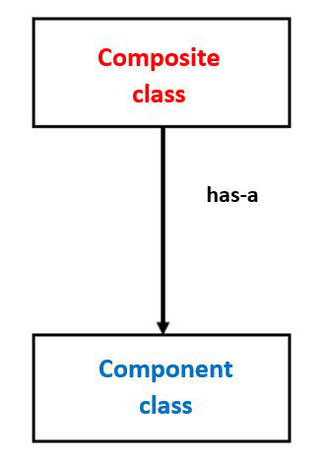
Composite Vs Component

Slide 8
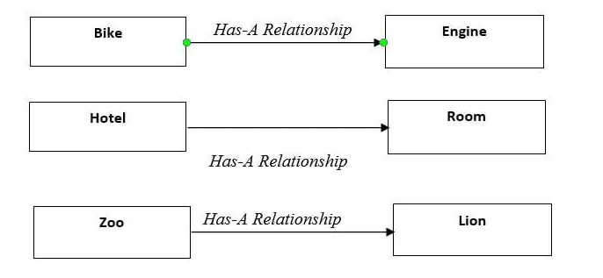
Examples

Slide 9
Examples
The class has a teacher
Zoo has a lion
The bike has an engine
It represents part of the relationship
Use Composition, when an object contains other objects, and the contained object can’t exist without other objects.

Slide 10
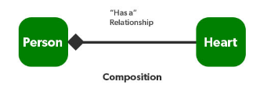
UML

Slide 11
Class Activity
Give examples for Composition in daily life.

Slide 12
Important Points
It defines a strong type of relationship (Has-a).
It can be defined as when a class can reference one or more objects of another class inside its instance variable.
In composition, objects can not exist independently.

Slide 13
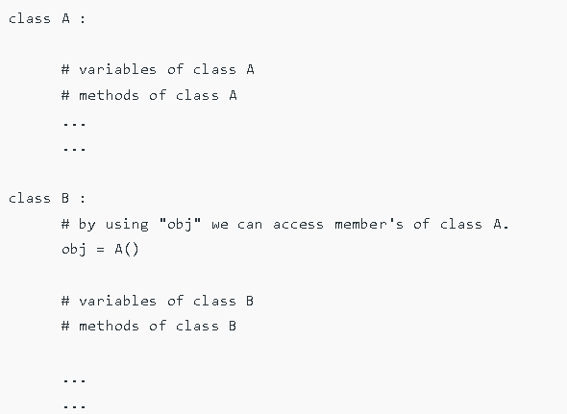
Composition in Python

Slide 14
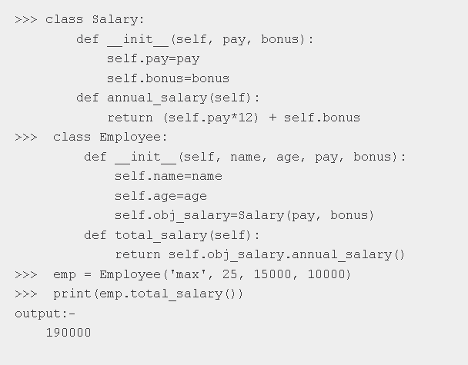
Composition in Python

Slide 15
When to use Composition?
We can only use that when we can not modify or extend the functionality of another class.
It will not provide extra features.
When one needs to use the class as it is without any modification, the composition is recommended.

Slide 16
Class Task
Create a class Book composed of pages.
Think class attributes and its behavior.

